Slide 1


Django Pair Project

Slide 2



Team List
Analisis Project
Database Model
Views & URL
Extra Preparation
Tantangan Mengerjakan Project
Cerita Sukses
Dan lain-lain
Demo Aplikasi
OUTLINE

Slide 3



Team List
Agung Aji Nugroho
Setyo Ramdhoni

Slide 4
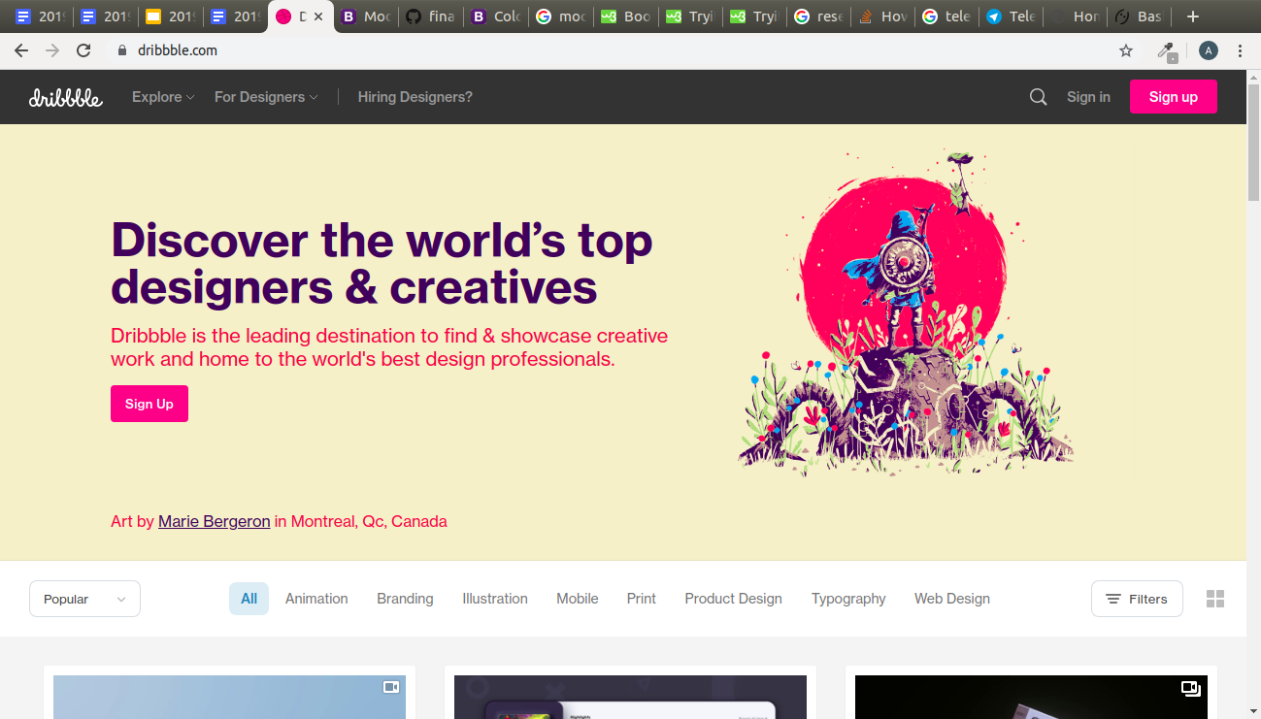
www.dribble.com

Slide 5
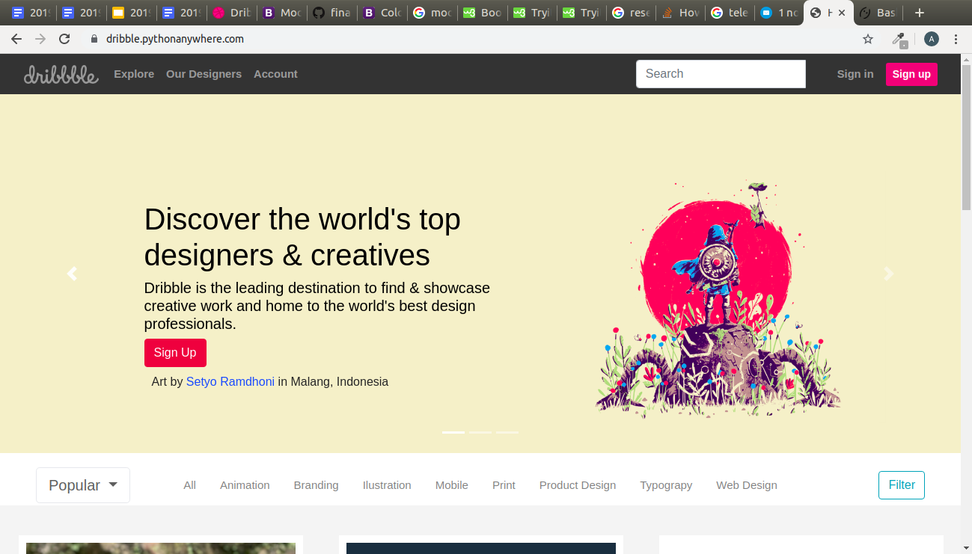
www.dribble.com

Slide 6



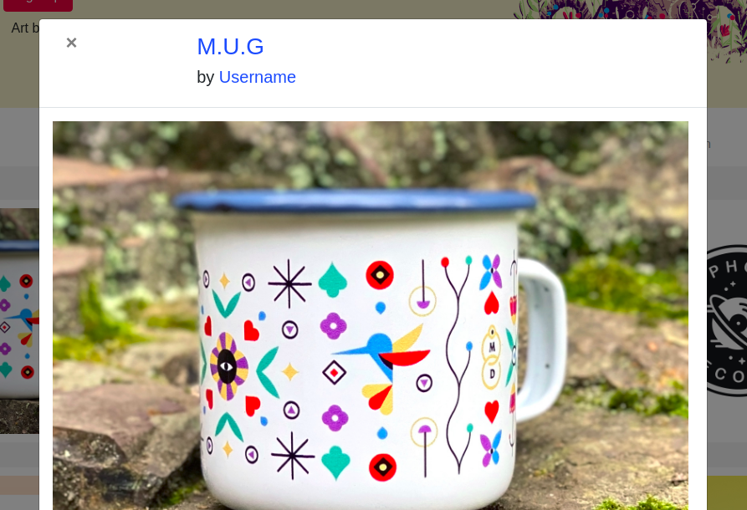
Analisis Project
3. Filter Post
1. Sign Up
2. Post Design
4. Fitur Modal (Pop Up)

Slide 7
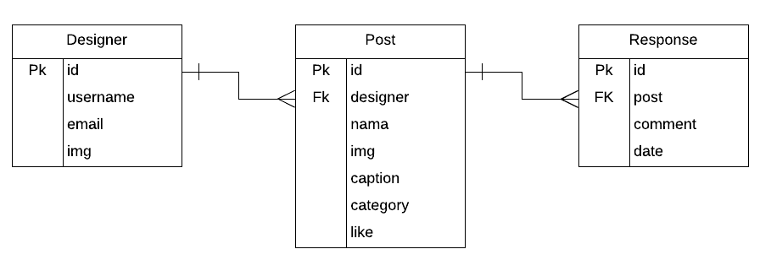
Database Model

Slide 8
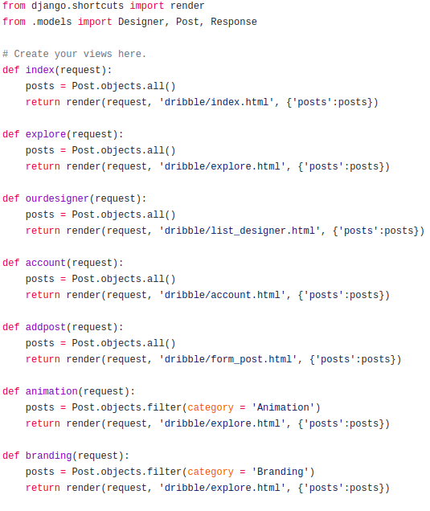
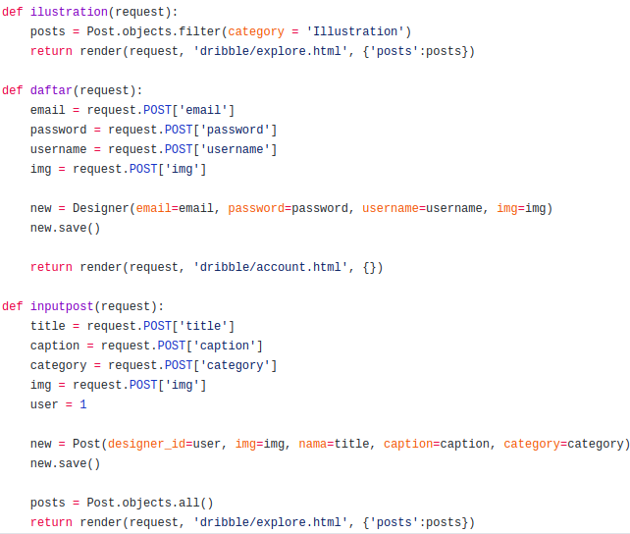
Views & URLs

Slide 9
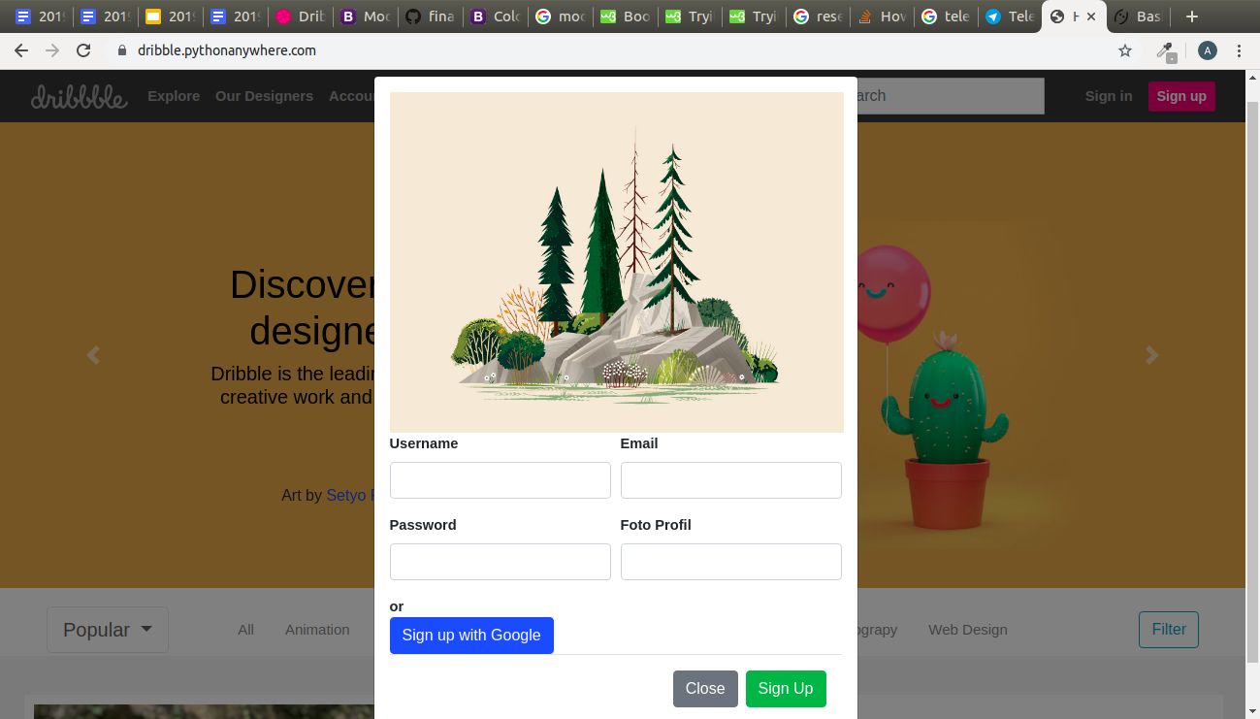
Extra Preparation

Slide 10
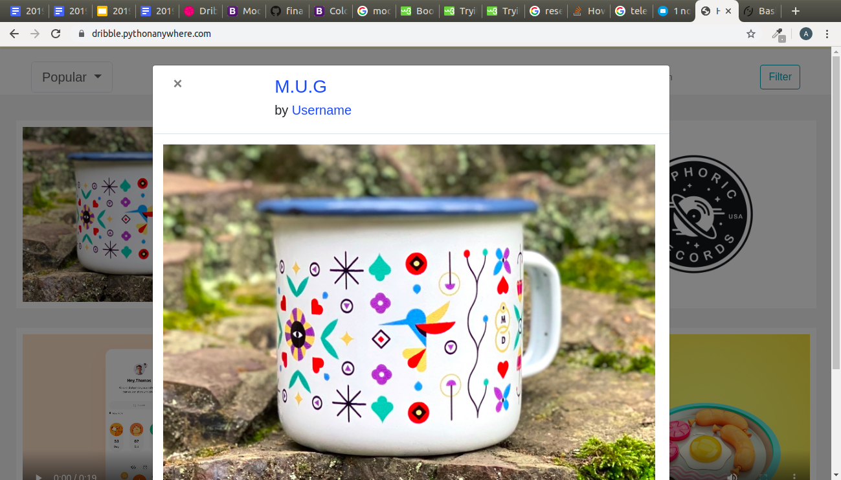
Extra Preparation

Slide 11
DEMO APLIKASI

Slide 12
Thank You

Slide 13
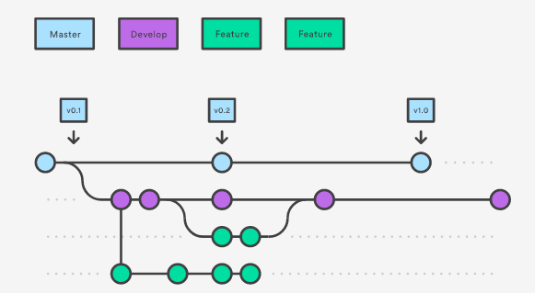
GitFlow

